Slide 1

The Art of Design Patterns
2023

Slide 2
Agenda
Structural Design Patterns
Decorator
Adapter
Facade

Slide 3
Structural Design Patterns
design patterns explain how to assemble objects and classes into larger structures, while keeping these structures flexible and efficient.
simplifies the structure by identifying the relationships.
These patterns focus on, how the classes inherit from each other and how they are composed from other classes.

Slide 4
Who loves pizza?

Slide 5

Who loves pizza?
Suppose we are building an application for a pizza store, and we need to model their pizza classes. Assume they offer four types of pizzas :
Peppy Paneer
Farmhouse
Margherita
Chicken Fiesta.

Slide 6
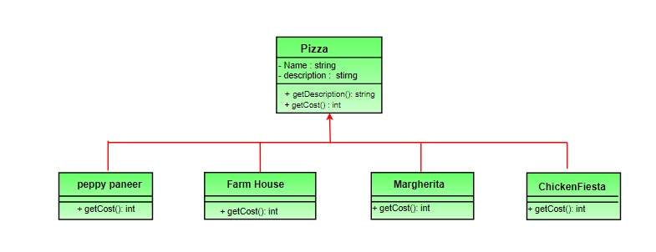
Solution
customer can also ask for several toppings

Slide 7
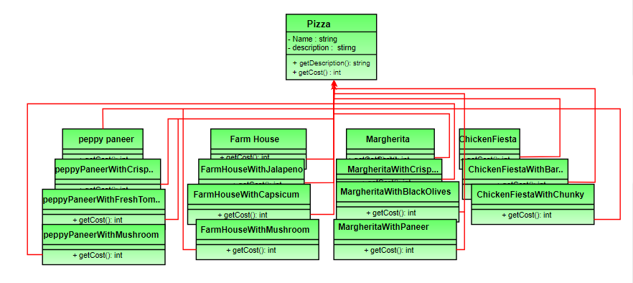
Toppings
Create class new class for the pizza with the new topping
Fresh Tomato
Jalapeno
mozzarella
Pepperoni
Sausage
Potato
Prosciutto

Slide 8
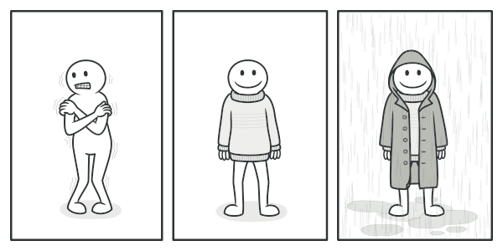
Decorator
a structural design pattern that lets you attach new behaviors to objects by placing these objects inside special wrapper objects that contain the behaviors.

Slide 9
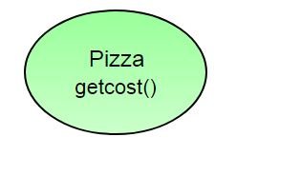
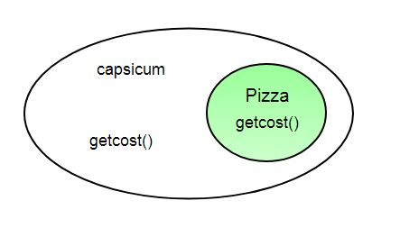
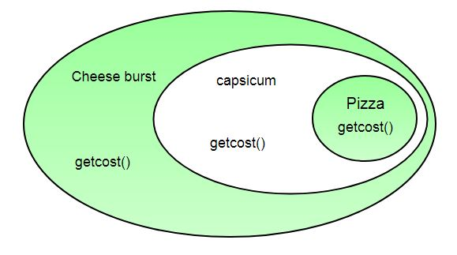
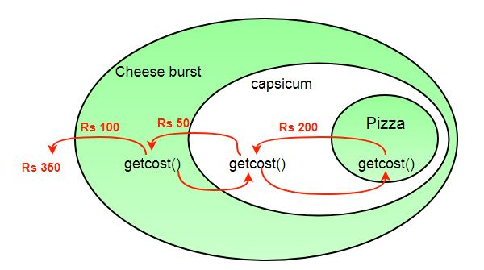
Decorator

Slide 10
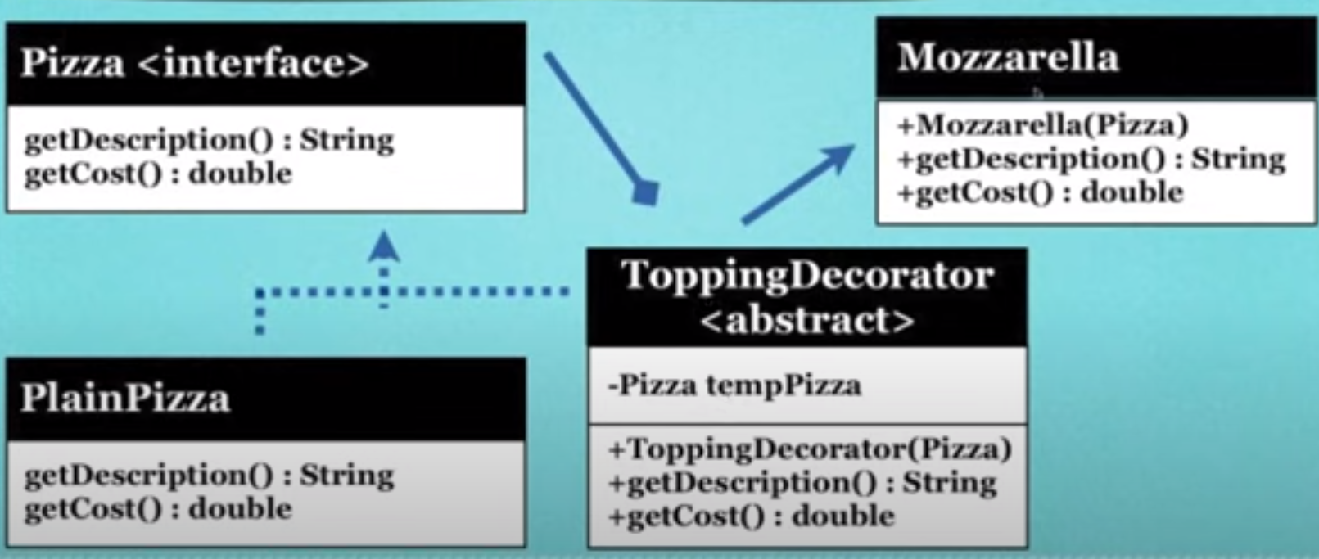
Decorator

Slide 11
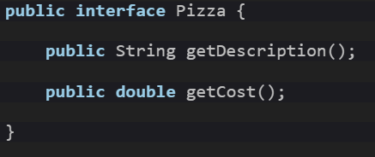
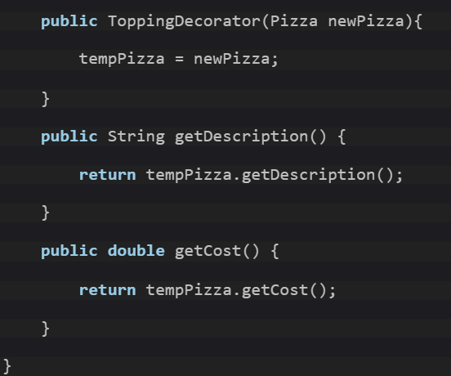
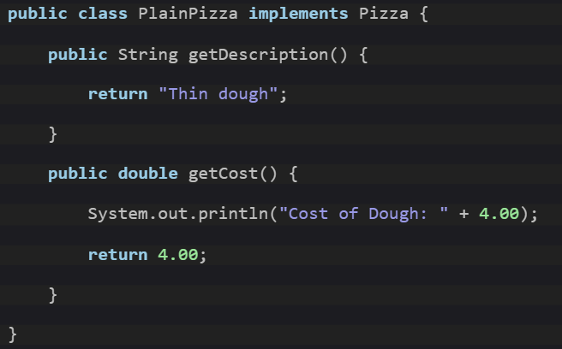
Code
Interface
Topping Decorator
Pizza object

Slide 12
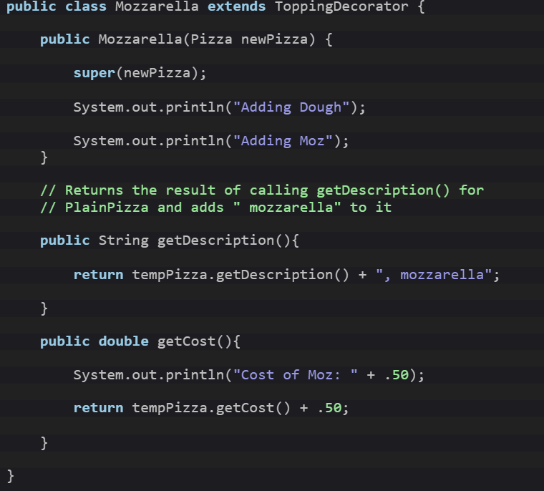
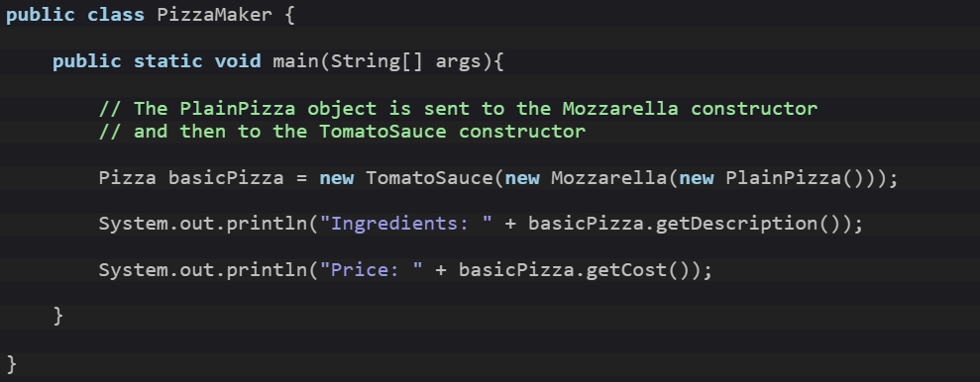
Code
Mozzarella
Main

Slide 13
Can u guess another real world Scenario?

Slide 14
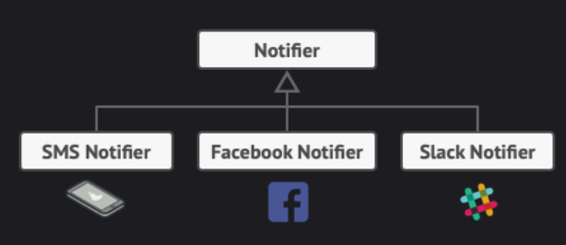
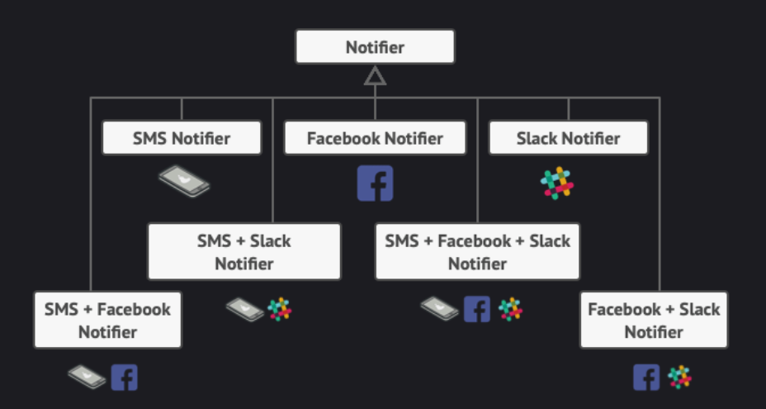
One More Scenario
Imagine that you’re working on a notification library which lets other programs notify their users about important events.
At some point, you realize that users of the library expect more than just email notifications. Many of them would like to receive an SMS about critical issues. Others would like to be notified on Facebook and, of course, the corporate users would love to get Slack notifications
Its your time to answer!

Slide 15
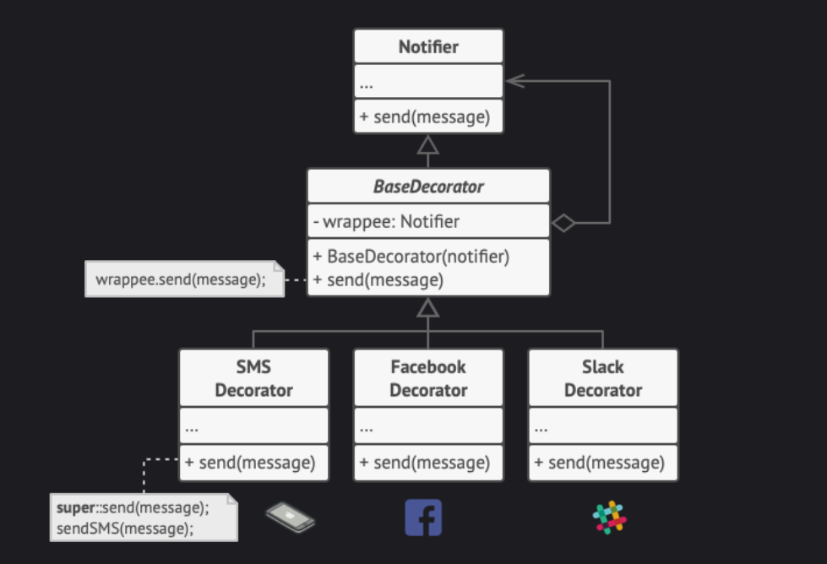
Solution

Slide 16

Advantages
You can extend an object’s behavior without making a new subclass.
You can add or remove responsibilities from an object at runtime.
You can combine several behaviors by wrapping an object into multiple decorators.
Single Responsibility Principle. You can divide a monolithic class that implements many possible variants of behavior into several smaller classes.

Slide 17

Disadvantages
It’s hard to remove a specific wrapper from the wrappers stack.
It’s hard to implement a decorator in such a way that its behavior doesn’t depend on the order in the decorators stack.
The initial configuration code of layers might look pretty ugly.

Slide 18
Adapter

Slide 19
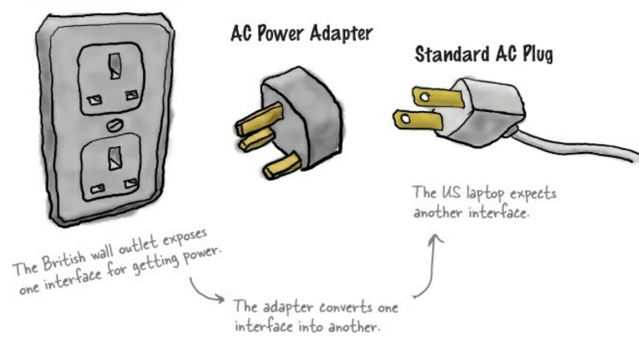
Adapter
is a structural design pattern that allows objects with incompatible interfaces to collaborate.
Note for latter
If it walks like a duck and quacks like a duck, then it must might be a duck turkey wrapped with a duck adapter

Slide 20
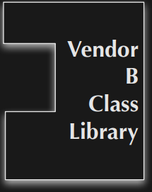
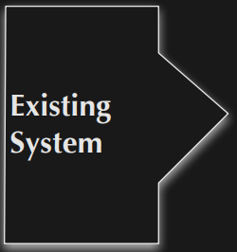
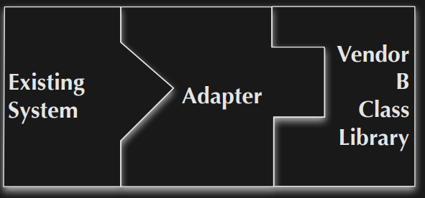
Real World Scenario
You are maintaining an existing system that makes use of a third-party class library from vendor A
Vendor A goes belly up and corporate policy does not allow you to make use of an unsupported class library.
Vendor B provides a similar class library but its interface is completely different from the interface provided by vendor A
Existing system and new vendor library do not change
new code is isolated within the adapter.

Slide 21
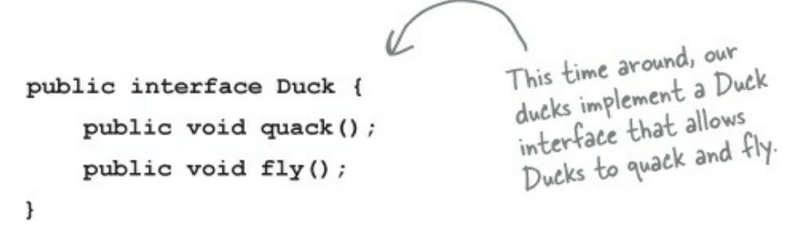

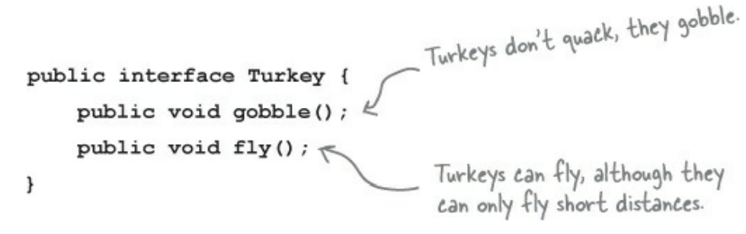
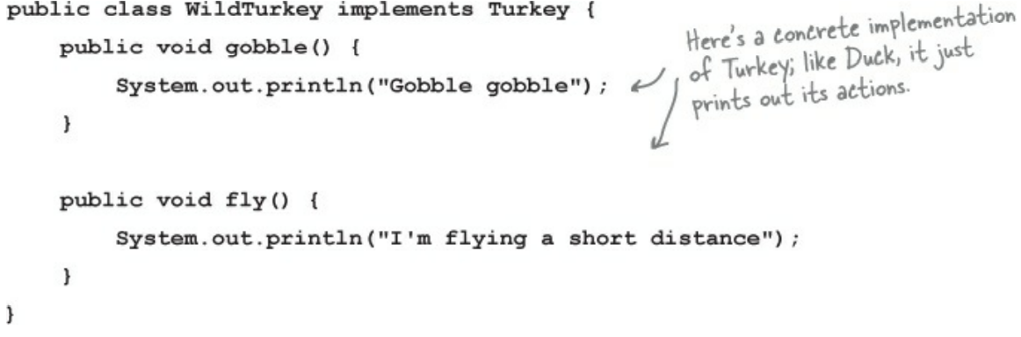
A turkey hiding among ducks!
→
→

Slide 22
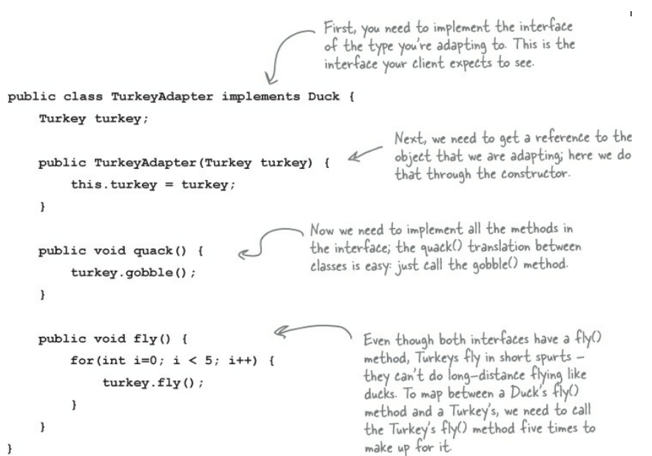
A turkey hiding among ducks!

Slide 23
Advantages
Single Responsibility Principle. You can separate the interface or data conversion code from the primary business logic of the program.
Open/Closed Principle. You can introduce new types of adapters into the program without breaking the existing client code, as long as they work with the adapters through the client interface.
Helps achieve reusability and flexibility.
Client class is not complicated by having to use a different interface and can use polymorphism to swap between different implementations of adapters.

Slide 24
Disadvantages
The overall complexity of the code increases because you need to introduce a set of new interfaces and classes. Sometimes it’s simpler just to change the service class so that it matches the rest of your code.
All requests are forwarded, so there is a slight increase in the overhead.

Slide 25
What is the difference with Adapter and Decorator?

Slide 26
What is the difference with Adapter and Decorator?
Adapter converts one interface into another while maintaining functionality
Decorator leaves the interface alone but adds new functionality

Slide 27
Facade

Slide 28
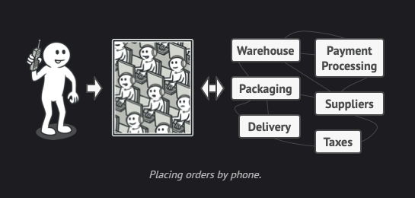
Facade
is a structural design pattern that provides a simplified interface to a library, a framework, or any other complex set of classes.

Slide 29
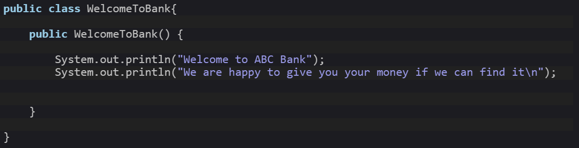
Real world Scenario
Designing Bank System and having the following class:

Slide 30
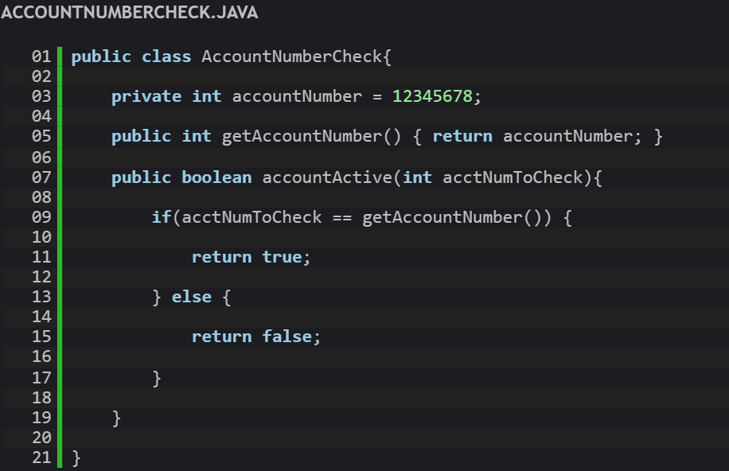
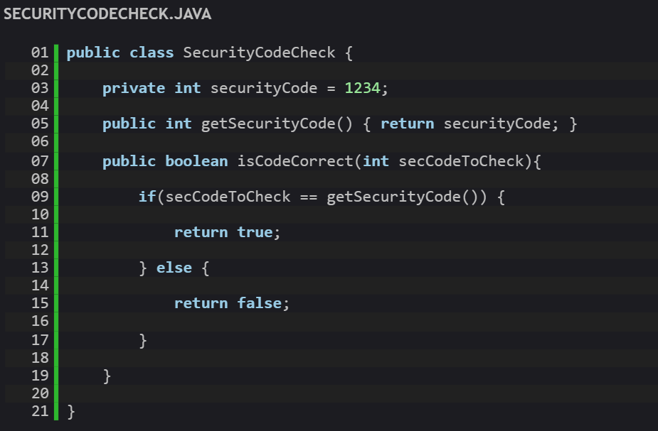
Real world Scenario
Designing Bank System and having the following class:

Slide 31
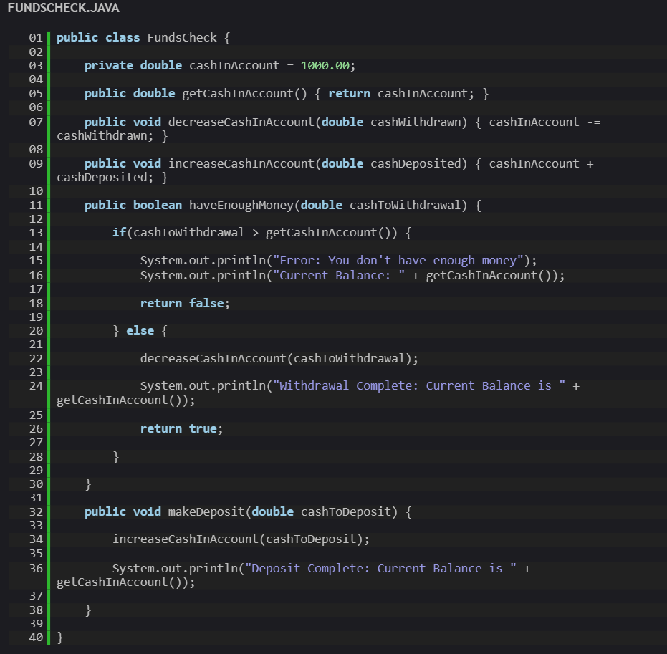
Real world Scenario
Designing Bank System and having the following class:

Slide 32
Can you see the problem?
In case a client wants to withdraw cash:
Get object from AccountNumberCheck to check the client account number.
Get object from SecurityCodeCheck to check the client Security Code.
Get object from fundcheck to check the account balance and decreases the money from the balance.
Noticed the problem?

Slide 33
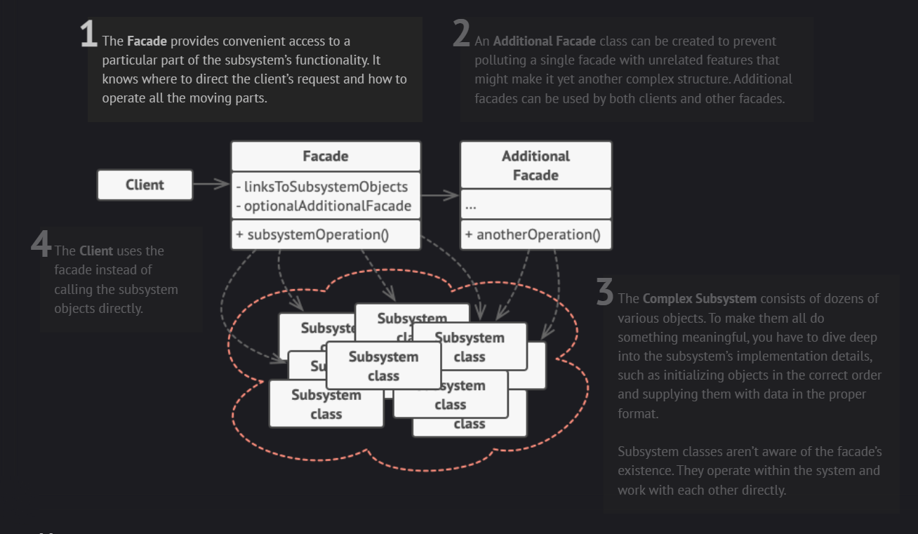
How to apply facade design pattern?

Slide 34
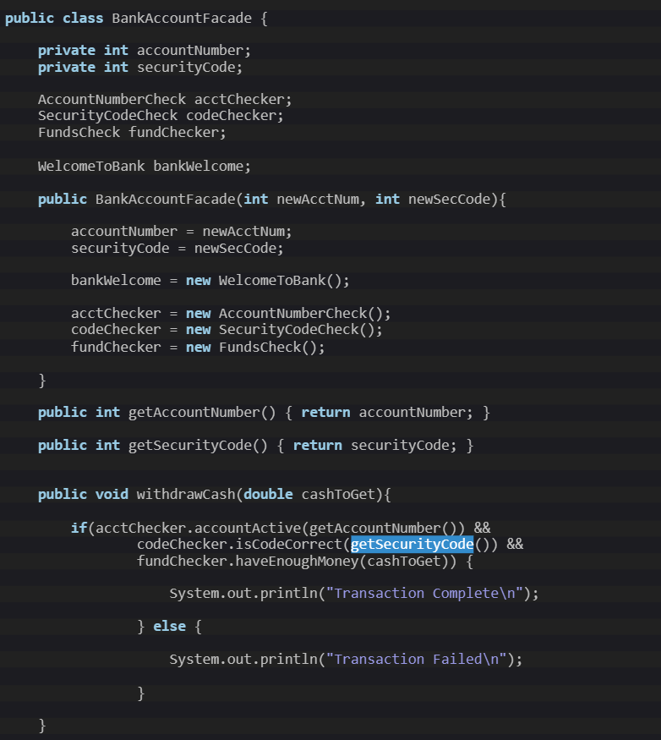
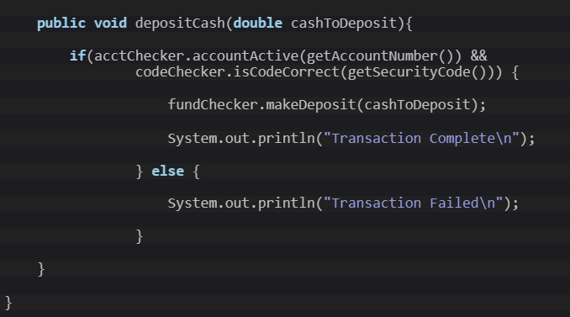
Solution

Slide 35
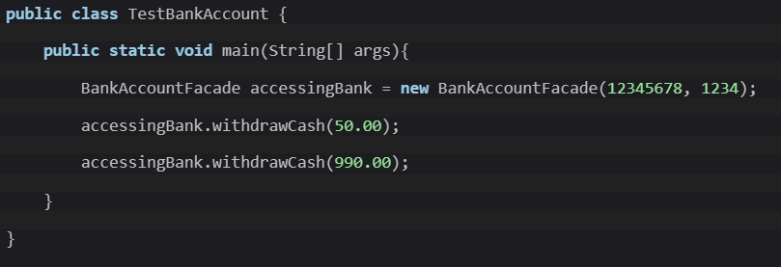
After applying the façade pattern
It became easier to access the objects in the right order make the withdraw operation.

Slide 36
Advantages
You can isolate your code from the complexity of a subsystem.
Software becomes more flexible and easily expandable

Slide 37
Disadvantages
A facade can become a god object coupled to all classes of an app.
Complex implementation (especially with existing code)
High degree of dependence at facade interface

Slide 38
Any Questions?

Slide 39
Thank you ☺

